Slide 1
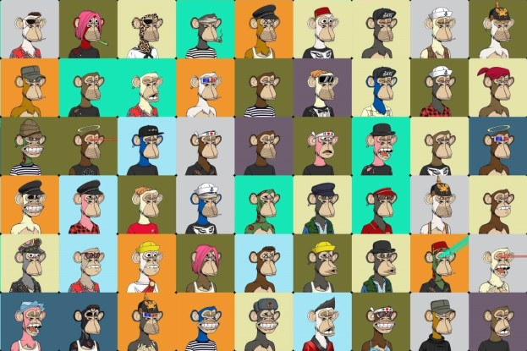
Image source: ant777.club
Notes:
Hello everyone, hoping today finds you well. So let me start with a question, when you see the picture in front of you, which ideas strike your mind. The most common notion would be that you are looking at a bunch of cool monkeys, dressed up, ready to party and have fun. Perhaps we can take it a step forward and try to understand the value of digital art and the various opportunities that follow from it.

Slide 2
NFTs
Elucidating the growth of through analytical and predictive models
BSC CS Final Year Project 2022-23
TAJ MUHAMMAD Waseem
56007063
Notes:
This is where my topic comes in, about NFTs and particularly about how we can analyse the growth of these digital assets. I am Waseem Taj and this is for my final year project in the department of computer science.

Slide 3
Table of Contents
01
02
03
04
Background
Definition, applications, trends, problem, existing solutions, objectives, scope of project,
System Design
Proposed solutions, methodologies
Evaluation
Implementation, testing and results, time complexity, market launch
Conclusion
Summary of project, future research
Notes:
Regarding the flow of the presentation, I will first give an overview of the project with any important definitions as well as the significance of NFTs in our current times. I will also talking about existing solutions and how they inspire my proposed design, so I will also set my own project’s objectives and scope in this section.
From there, in the next section, I will provide a deeper look into the system specifications. In the third section, the implementation of the methodologies would be highlighted and any results and testing will be discussed along with deployment of NFTs to marketplace. Finally, I will conclude by shedding a light on what my project has achieved ultimately and what else can be done in the field of NFT-related research.

Slide 4
01
Background
Notes:
Starting with the background

Slide 5
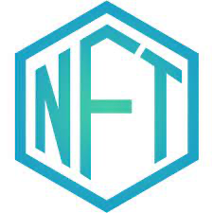
Definition
are ownable, verifiable, and immutable digital assets hosted in the metadata on blockchain technology.
Non-Fungible Tokens (NFTs),
Notes:
Let’s start with the basics, NFT is an acronym for Non-fungible tokens, fungible just being a fancy word for being non-interchangeable irreplaceable and non-exchangeable asset similar to how you would not be able to replace a baseball card or a diamond with unique features, and the only way to acquire them would be to pay the monetary value of that asset. By hosting NFTs on blockchain, it allows for the creation of a tamper-proof and transparent record of ownership and transfer.This means that once an NFT is created, its ownership and authenticity can be easily verified and traced, and it cannot be duplicated or destroyed.

Slide 6
Common applications
Finance
Legal
Entertainment
DeFi, cryptocurrency loans and digital ledgers
Smart contracts and digital property records
Virtual assets trading in Metaverse, games, ticketing
Marketing
Automotive
Advertisements and celebrity endorsements
Distributed intelligence networks in autonomous vehicles
Notes:
Because of their tamper-resistant properties, NFTs are used in a variety of applications. In the field of finance, the application is of interest both to the consumers who do not need an intermediary like a bank where the transactions can be processed securely and verified both on the sender and receivers’ end. This concept is called decentralised finance (DeFi) which banks nowadays are also looking at, with the prospect of incorporating NFT-based blockchain as digital ledgers for customer information instead of relying on the traditional swift network of banks. In the legal field, once again, the integrity of the blockchain can host metadata including user info to establish smart contracts and records which cannot be tampered with. Marketing and entertainment industries create more hype for their products and give an extra incentive to the consumers with NFTs. Lastly, NFTs are being used to tokenize intelligence in metadata for quantum reinforcement learning for connected and distributed intelligence networks in autonomous vehicles.

Slide 7
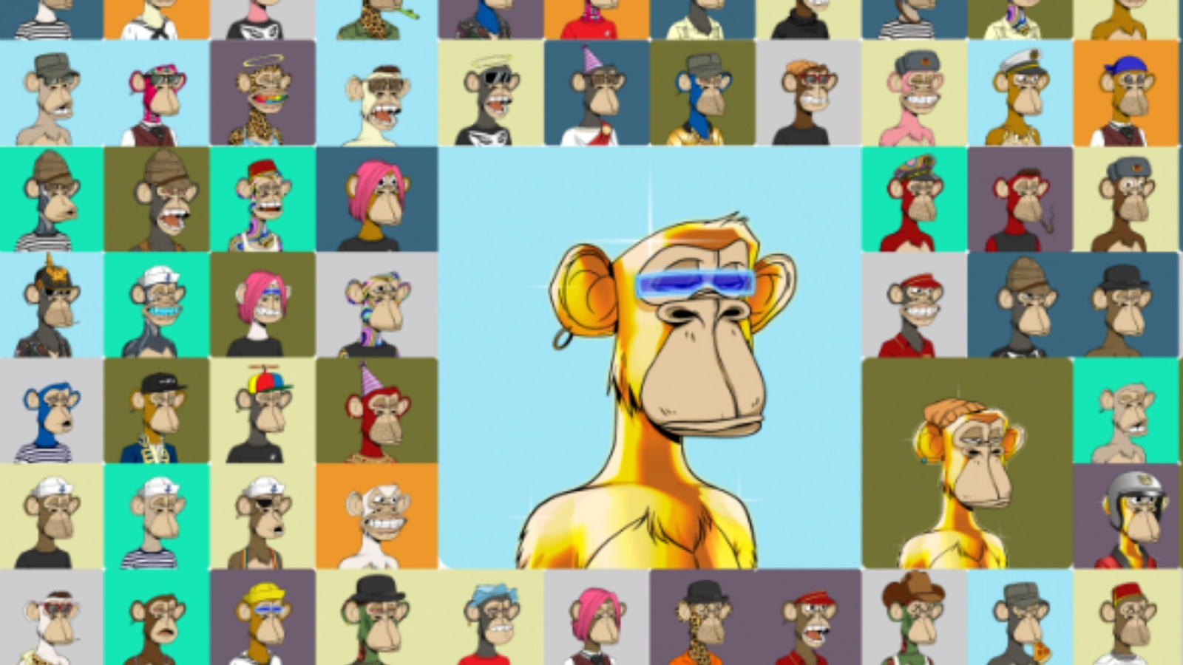
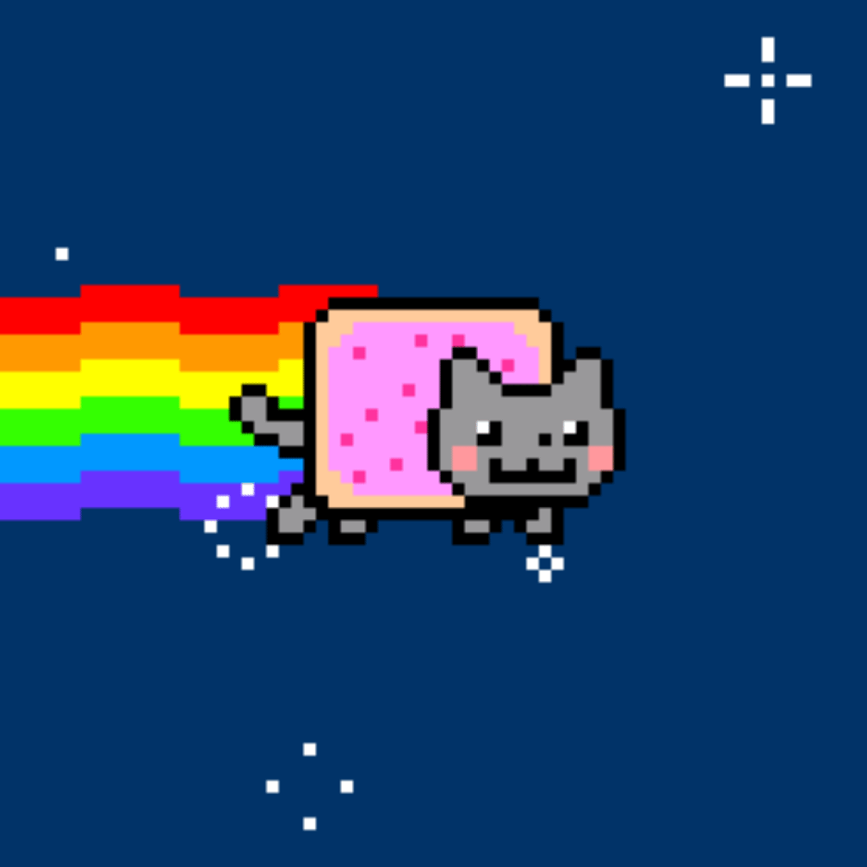
Gif source: Kapwing
Image source: The art of the bubble
Notes:
The application which is in the scope project is NFT as digital asset or art and exploration of the NFT marketplace. Indeed, the very first set of images I showed, is associated with one of the first collections to popularize NFTs, the bored ape yacht club which is now valued at 2 billion USD. It is important to note that apart from static images, NFTs also come in the form of other animated multimedia like this Nylan Cat gif which started as an internet meme but was remastered and sold for half a million USD as an NFT.

Slide 8
The market trends
17.6 billion USD
80 billion USD
8 million units
Traded in NFTs in 2021
Total market valuation by 2025
New NFTs launching every month
Notes:
Looking at similar NFT market trends generally, we see some promising numbers. Firstly, a total of 17.6 billion USD was traded in NFTs in 2021 Jefferies Group reports total market valuation will cross 80 billion USD by 2025. Lastly, artists on a monthly basis launch up to 8 million units in the market. Such market influence coupled with a wide range of applications and investment potential make me interested to perform a deeper analysis on the growth of NFTs.

Slide 9
Current developments in Asia - gaming
“Play-to-earn”
Whitelisted by Japan, Philippines, Vietnam and Hong Kong
Trade or mint NFTs proportionally to playtime in games.
Splinterlands
Popular game, 4 million transactions per day in August of 2021
Axie Infinity
Another online NFT-based game, Axie Infinity saw a jump of 5000% in active players (upto 2 million) in 6 months only
Animoca Brands
Hong Kong based blockchain gaming company, generated revenue of USD 5 billion.
Notes:
Recently, the increased flexibility of online payment modes surrounding decentralized transactions has allowed NFTs to penetrate the Asian gaming market which now employing the Play-to-earn model to allow players to mint and trade NFTs. This has been the case across Japan, Philippines, Vietnam and Hong Kong with NFT-based games like Splinterlands and Axie Infinity generating huge uptick in transactions and hong kong based blockchain gaming company, Animoca Brands geenrating over 5 billion USD

Slide 10
Current challenges
Analysing valuation of NFTs
Lack of studies on metric correlation, financial indicators and statistical research
Predicting growth of market
Lack of predictive models to gauge and project future NFT sales.
Inadequate NFT launch strategy
Lack of clear guidelines for newcomers to enter market
Notes:
Currently, some problems and challenges NFT industry face and I would like to highlight them briefly as the “lack of “ something. So firstly, there is not sufficient research or indicators to categorise and correlate the metrics of successful NFTs. Secondly, the lack of predictive models make it tough to accurately project future success of NFTs. Lastly, for newcomers who either want to publish or purchase an NFT , the oversaturated market with a host of tools, might make it perplexing for them to find out which route to take as their starting point. So to build a well-informed opinion and a lucrative decision, a buyer can benefit by understanding the various features and metrics associated with NFT assets and how these indicators drive NFTs’ valuation and success.

Slide 11
Current solutions
Research
Topic
 | Nadini et al., (2021) | Vasan et al., (2022) | Kipf & Welling (2017)
Blockchain specificity
Artists’ reputation
Graph Neural Network
Not relevant
Not used
Used
Notes:
The current solutions which forms the basis of literature review for my project is summarised in this matrix. As the key highlights, a cross means the research was not used used for inspiration while a tick indicates that ideas from that research were relevant to my project. So for instance, a cross on topic of blockchain specificity indicates that this research did not take into account Solana blockchain which I used for my project as it is gaining quite a lot of traction recently for NFT transactions. A hyphen indicates that the study is not relevant to the topic associated.

Slide 12
Project’s objectives
Evaluate success
Launch success
Decision tree algorithm to correlate success of NFTs to chosen metrics
Predict success
Generation of unique NFTs, market specifications and launch
Training Graph Neural network to derive useful predictions from NFT data for future profitability
Notes:
To address these challenges, my project’s objective is thricefold and I would like to think of these as three successes. Firstly, we should be able to evaluate what success itself for NFTs means, in terms of their metrics and the correlation for which I utilise decision tree. Secondly, to predict NFTs’ success, a graph neural network is trained on graph structured data
Lastly, industry-standard practices will be laid down along to make it clear to the newcomers on how they would generate NFTs, and consequently launch them into the market.

Slide 13
Project scope
Social Media Marketing
Pre and post-launch NFT social media marketing
Limiting number of NFTs generated
Designing artwork
100 NFTs generated for market launch showcase despite 50,000 max possible permutations
NFT artist draws artwork independent of this project
LIMITATIONS
Notes:
Before I proceed to the system design, there are some limitations worth noting to define the scope of the project. Social media marketing for NFTs both pre and post launch falls into the domain of marketing analysis and is beyond the scope of this research. Similarly, guidelines on drawing the artwork is more suitable for research in a different domain. Lastly, although the program to be shown later is capable of generating up to 50,000 unique NFTs for a series, for the demonstration purpose of this project, I have set the limit to 100 NFTs to be generated for simplicity.

Slide 14
02
System Design
Notes:
How do I aim to implement such solutions?

Slide 15
Proposed solutions
NFT analysis
Correlation between various metrics of NFTs and their success
Data collection
Data usage
OpeanSea API (Solana)
Decision tree algorithm (metric classification) Graph Convolutional Network (graph structured data), linear regression model (sales prediction)
NFT initialization
NFT publication
HashLips Solana art engine (NFT series generation), Phantom wallet (Solana transaction)
LaunchMyNFT (publishing NFTs), Mainnet (Magic Eden launch), SolScan.io (post-launch test)
NFT Launch
NFTs’ generation, publishing and minting processes
Notes:
This will be a brief overview of the solutions I propose. On the more technical side, NFT analysis is carried out where data is collected for NFTs metadata through OpenSeaAPI predominantly for Solana blockchain based NFTs. The collected data facilitates the decision tree algorithm for metric classification and the graph convolutional network trains on the graphical representation of trade network of NFT to identify factors and patterns in successful NFT so a linear regression model can make valuable predictions,
For NFT Lunach, NFT series generation will rely on the industry benchmark tools of Hashlips Solana art engine to verify the metadata and publishing the NFTs. The Post-production phase will see NFT first be tested on the minting dApp of LaunchMyNFT before it can be launched on the Magic Eden marketplace and verified post-launch on SolScan.io

Slide 16
NFT analysis
Prediction
Linear Regression Model
Node embeddings generated by GNN to be used as inputs to train model and make predictions
Graph Neural Networks (GNN)
Evaluation
GNN uses the Graph Convolutional Network (GCN) algorithm to evaluate success and train linear regression model
Decision Tree Algorithm
Classification
API called to collect data on prominent and researched metrics to generate tree/graph categorisation of NFT data
Notes:
It is helpful to take a look at how NFT analysis is carried out through a bottoms up approach. Starting from the decision tree algorithm, it works by recursively splitting the dataset into smaller subsets based on the value of a selected feature until a certain stopping criterion is met, such as a maximum depth or minimum number of samples required for each split. Each split creates a new internal node in the decision tree, and the final nodes which contain the predicted values for the target variable.
GNN algorithm is using a graph representation of the NFT trading network facilitate by Graph Convolutional Network algorithm,, which applies series of mathematical operations to each node and its neighboring nodes to extract meaningful features that describe the network structure.
This is intrepretaton of the network in terms of node embeddings is used as inputs to train linear regression model and make predictions so in this way the model will use the independent variables like artists’ reputation, rarity etc to predict the dependent variable, which is the price of the NFT.

Slide 17
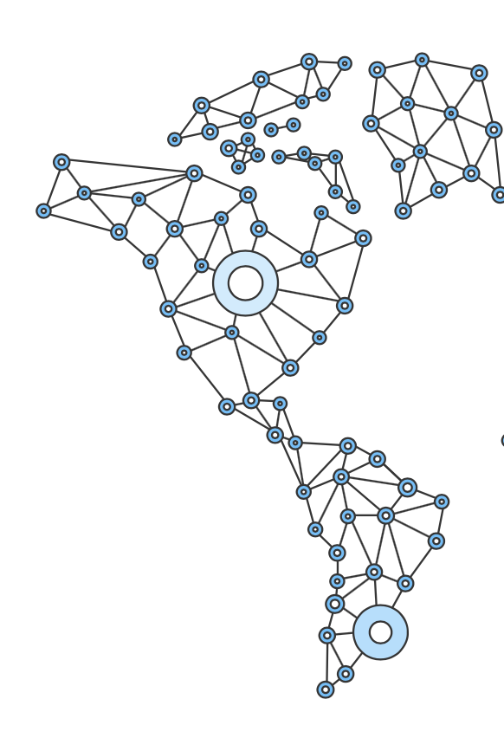
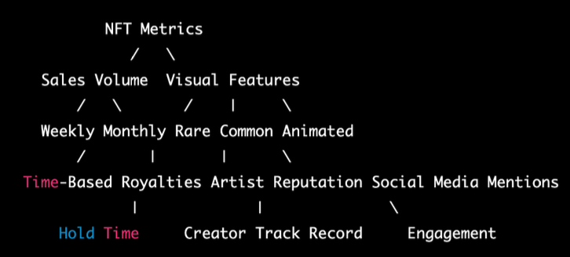
NFT analysis
Metric classification
Graph structured data
Decision tree for principle categories broken into sub-categories like sales volume and visual features
Additional metrics have been associated like royalties for rare NFTs and community engagement for Artists’ reputation.
GCN aggregates feature information of neighbouring nodes for structural and relational information.
Nodes represent NFTs and edges represent their relationship.
Notes:
The metrics chosen which potentially serve as good independent variables to derive NFT success from, are shown in the decision tree above. Here you can notice that principle categories like sales volume maybe broken down into subcategories of weekly and monthly sales.
GNN algorithm is using a graph representation of the NFT trading network, powered by GCN, which has aggregation feature as key component of its functionality. So here the nodes represent NFTs, and the edges represent relationship between them such as such as similarity or co-occurence.

Slide 18
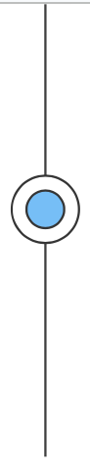

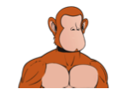
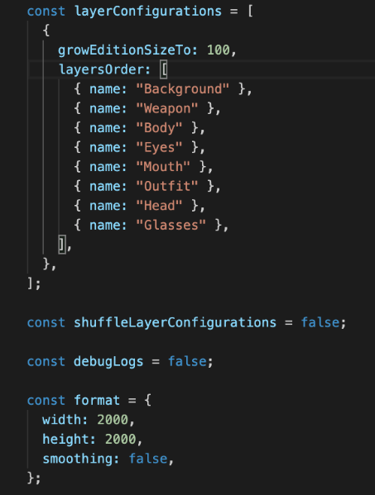

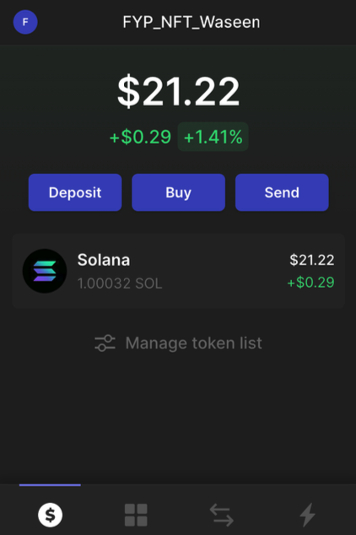
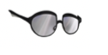


NFT Launch
Step 1
Step 2
Step 3
Optimizing artwork
Generating series
Publishing NFTs
Different components of NFTs separated into layers for randomisation
Hash Lips Art Engine used to generate Solana-based NFTs with appropriate specifications.
Phantom Wallet connected for SOL fee, LaunchMyNFT and MagicEden used for launching and minting NFTs
LaunchMyNFT
MagicEden
Notes:
Moving on to NFT launch, we first segregate NFT artwork, which has been created originally for this project, into different layers . This helps the program understand and randomise each layer and hold that information to generate up to 100 unique NFTs having no mutually exclusive layer between them. To publish these NFTs a minting dApp like LaunchMyNFT is integrated with Phantom wallet containing sufficient SOL fee for transaction and then subsequently pushed to MagicEden marketplace.

Slide 19
03
Evaluation
Notes:
This brings me to the evaluation section

Slide 20
Decision Tree
Data preprocessing
Testing
Data gathered via open-source API converted to categorical format, scaled and normalised, and finally split into training and testing sets for model building
Sample of NFT data from open-source platforms which is split into testing set, evaluates accuracy of algorithm in terms of accuracy, precision and F1-score.
Model definition
Results
After defining architecture of model including number of layers, nodes and activation functions, the model is trained on the data set and tested on training set, with appropriate optimizer (Mean squared error) and loss function (Adam).
T-test for computing statistical difference between two sets of means and standard deviation from two methods calculated in pair-wise manner.
Notes:
These sliders are quite self-explanatory as they delve into 4 main ideas for each of the two techniques used. So I will touch on them briefly. For data preprocessing, collected data is scaled and normalised and split into training and testing sets, the model is then train and tested with appropriate optimizer and loss function. The sample of NFT data is tested in terms of accuracy, precision and F1-score. Finally the results are calculated with t-test in pair-wise manner.

Slide 21
Graph Neural Network
Data preprocessing
Testing
NFT data is split into training and testing sets, graph representation of NFT data obtained via graph library (NetworkX) and converted to PyTorch geometric graph data object
The predicted sales/profitability values of GNN algorithm were compared with actual sales/profitability values of the test set via mean squared error (MSE) and mean absolute error (MAE) metrics.
Model definition
Results
GCN algorithm trains the model to generate node embeddings for all nodes in the graph as input features for linear regression model. T-test used to evaluate performance of GNN model with baseline linear regression model
The GNN algorithm achieved MSE of 0.05 and MAE of 0.22 on test set. T-test results showed GNN model outperformed baseline linear regression model with p-value of less than 0.05.
Notes:
For graph neural network, The PyTorch Geometric library is used to preprocess the data into a graph structure where each node represents an NFT and the edges represent the price relationships between the NFTs. The graph neural network model uses two graph convolutional layers and one linear layer to predict the profitability of each NFT based on its price and supply. The model is trained on the preprocessed data using mean squared error and mean absolute error for testing. The results of mSE of 0.05 and MAE of 0.22 show that the GNN model implemented outperforms the baseline linear regression model which is a definite improvement

Slide 22
Time Complexity
Collecting Data
Creating Visualization
Depends on number of assets returned by API and number of attributes collected. The program is collecting the sale count and image URL of each asset at O(n), where n is the number of assets returned by the API.
Depends on size of input data for creation. The program creates a scatter plot of the sale count and image URL of each asset at O(n).
Processing Data
Predicting profitability
Depends on number of assets retrieved and complexity of data. The program retrieves the last sale price and total supply of each asset to calculate the sales/profitability of each assets at O(n), where n is the number of assets retrieved and processed
Depends on size of input data and complexity of model. The program predicts the sales/profitability of new NFTs based on the trained model at O(n) where n is the number of new NFTs being processed.
Notes:
The time complexity for different parts of the program can be broken down into 4 main functionalities. Firsty, that of collecting data using the OpenSea API depends on the number of assets returned by the API and the number of attributes being collected. In this case, the code is collecting the sale count and image URL of each asset. Therefore, the time complexity of this section would be O(n), where n is the number of assets returned by the API.
Secondly, for creating visualization, it is determined by the size of the data. In this case, the program is creating a scatter plot of the sale count and image URL of each asset at O(n), where n is the number of assets returned by the API.
The time complexity of processing data is determined by the number of assets being retrieved and the complexity of the data processing. In this case, the program is retrieving the last sale price and total supply of each asset, and using this data to calculate the sales/profitability of each asset and it will be O(n) for the assets retrieved and processed.
The time complexity of prediction of profitability for future NFTs depends on the size of the data and the complexity of the model. In this case, the program is predicting the sales/profitability of new NFTs based on the trained model. The time complexity of this section would be O(n), where n is the number of new NFTs being processed.

Slide 23
NFT series
Notes:
Here we have all 100 unique NFTs gendered from Hash Lips’ Art Engine with randomisation of layers.

Slide 24
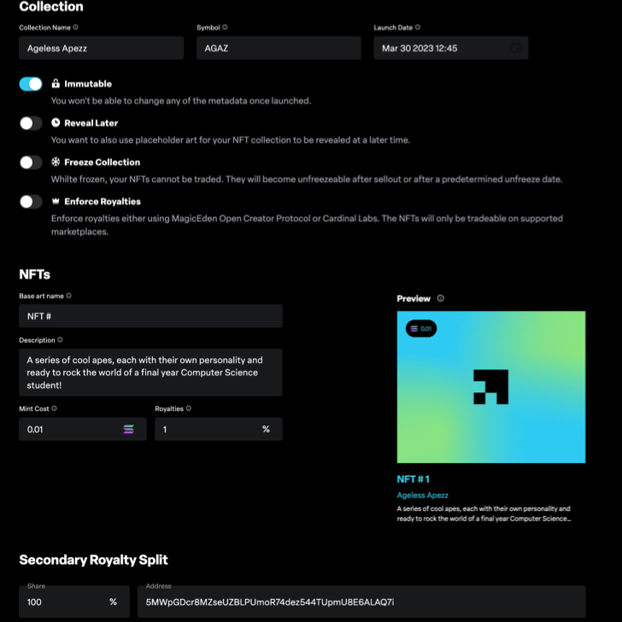
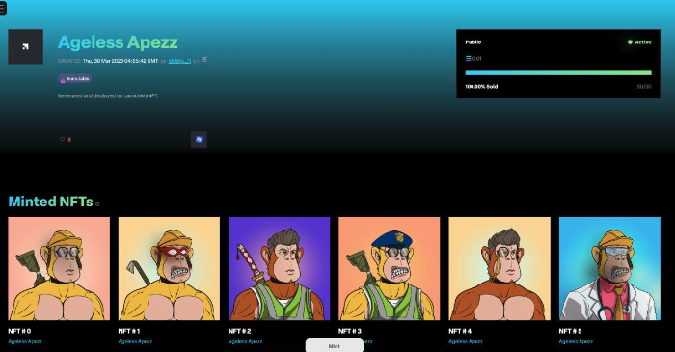
NFT Launch
Collection preferences
Specific specifications are set including immutability (non-modifiable), description, mint cost (purchase cost), royalty percentage and secondary royalty split (shares), before being launched deployed on minting dApp, LaunchMyNFT (below)
Notes:
On the left image, you can see the specifications which the owner can set according to their desire. These include settings like mint cost, royalty percentage and immutability among others. The pic on the right is the result when a seller will mint or purchase the NFTs.

Slide 25
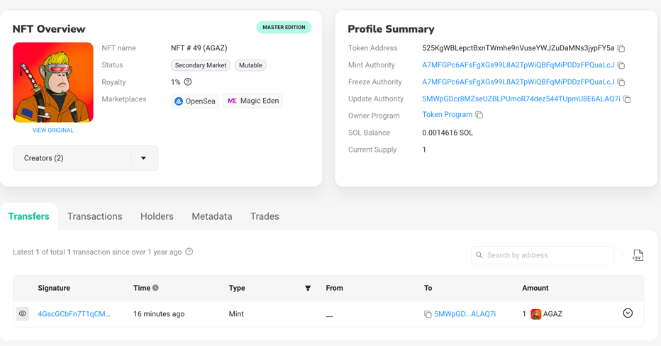
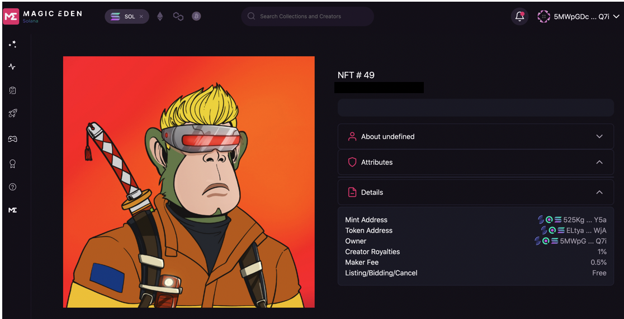
NFT Launch
Verifying NFTs
NFTs are verified with SolScan testing with metadata, token address, each transaction and owner details hosted on the blockchain for anyone to validate.
Marketplace deployment
NFT published on Solana-based NFTs marketplace, Magic Eden with attributes and details, for anyone to mint
Notes:
Every little detail of the NFT can be confirmed and traced on SolScan under the various tabs of transactions and trades. It also provides a summary, so the whole process is transparent. Finally, NFTs published on Magic Eden are viewable by other sellers to mint as well. This process will be covered step by step in the demo later as well.

Slide 26
04
Conclusion
Notes:
This leads me to the conclusion

Slide 27
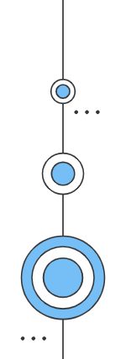
Outlook
Summary of project
Future research
Provide professionals with key indicators of NFTs’ success by evaluating metrics via decision tree
Connected and autonomous vehicles (CAVs) present promising NFT protocol usage by tokenizing intelligence in metadata for distributed intelligence networks
Novel approach of using GNN for analyzing NFT data to predict profitability
Possible negative externalities impacting prediction for NFT sales including geopolitical issues, pandemics and economic recessions.
Inspire confidence in amateurs and newcomers to the market by simple and effective marketplace launch approach
Notes:
To summarise, I can say with confidence that this research-oriented project, meets its intended goal by giving professionals and newcomers alike the key indicators of NFT’s. Using the novel approach of using GNN for graph data, the predictions for NFT future sales have obtained good results with promising values on the loss function and time complexity of program. Lastly, a simple NFT generation and market launch process will allow newcomers to make their first foray into NFT marketplace.
Given the scope of my project there are some aspects I believe future research can focus on including NFTs usage in connected and autonomous vehicles to tokenize intelligence and how negative externalities may impact NFTs including factors like geopolitical matters of war like the ukraine and russia conflict,, economic recession or even comments from key economic player and influencers like Elon Musk.

Slide 28
Thank you
Notes:
That’ll be all, thank you for your time and patience.

Slide 29
References
Browne, R. (2022, March 10). Trading in nfts spiked 21,000% to more than $17 billion in 2021, report says. CNBC. Retrieved October 19, 2022, from https://www.cnbc.com/2022/03/10/trading-in-nfts-spiked-21000percent-to-top-17-billion- in-2021-report.html
FinSMEs. (2022, August 10). The growing popularity of nfts. FinSMEs. Retrieved October 19, 2022, from https://www.finsmes.com/2022/08/the-growing-popularity-of-nfts.html
Kipf, T. N., & Welling, M. (2017, February 22). Semi-supervised classification with graph Convolutional Networks. arXiv.org. Retrieved November 15, 2022, from https://arxiv.org/abs/1609.02907
Nadini, M., Alessandretti, L., Di Giacinto, F., Martino, M., Aiello, L. M., & Baronchelli, A. (2021, October 22). Mapping the NFT revolution: Market trends, Trade Networks, and visual features. Nature News. Retrieved October 21, 2022, from https://www.nature.com/articles/s41598-021-00053-8
Nayazunissa. (2021, October 18). Axie Infinity's daily active users increased by almost 5,000% in six months. TheNewsCrypto. Retrieved April 11, 2023, from https://thenewscrypto.com/axie-infinitys-daily-active-users-increased-by-almost-5000-in-six-months/
NFT-based intelligence networking for connected and autonomous vehicles: A Quantum Reinforcement Learning Approach. IEEE Xplore. (n.d.). Retrieved October 21, 2022, from https://ieeexplore.ieee.org/document/9852376/
Non-Fungible Tokens Market Global Growth Drivers & Opportunities. MarketsandMarkets. (n.d.). Retrieved April 11, 2023, from https://www.marketsandmarkets.com/Market-Reports/non-fungible-tokens-market-254783418.html
Minter, R. (2022, May 5). Bored ape yacht club surpasses $2 billion in all-time sales. BeInCrypto. Retrieved November 27, 2022, from https://beincrypto.com/bored-ape-yacht-club-2-billion-sales/
Stanley, A. (2021, February 20). One-of-a-kind nyan cat gif sold in crypto art auction to celebrate Meme's 10-year anniversary. Gizmodo. Retrieved November 28, 2022, from https://gizmodo.com/one-of-a-kind-nyan-cat-gif-sold-in-crypto-art-auction-t-1846312536

Slide 30
References
Vasan, K., Janosov, M., & Barabási, A.-L. (2022, February 17). Quantifying NFT-driven networks in crypto art. Nature News. Retrieved October 21, 2022, from https://www.nature.com/articles/s41598-022-05146-6
Yahoo! (n.d.). Jefferies sees the NFT market reaching more than $80B in value by 2025. Yahoo! Finance. Retrieved October 20, 2022, from https://finance.yahoo.com/news/jefferies-sees-nft-market-reaching-160604950.htm

